Slide 1
Distributed process management:
Distributed deadlock

Slide 2
Distributed deadlock
Problem definition
  Permanent blocking of a set of processes that either compete for system resources or communicate with each other
  No node has complete and up-to-date knowledge of the entire distributed system
  Message transfers between processes take unpredictable delays
Types of distributed deadlock
  Resource deadlock
    Set of deadlocked processes, where each process waits for a resource held by another process (e.g., data object in a database, I/O resource on a server)
  Communication deadlocks:
    Set of deadlocked processes, where each process waits to receive messages (communication) from other processes in the set.

Slide 3
Distributed deadlock (cont.)
System state representation with wait-for graphs (WFG)
  Nodes are processes, P1, P2, etc.
  Directed edge from P1 to P2 if P1 blocked and waiting for P2 to release a resource
  System is deadlocked if there is a directed cycle

Slide 4
Deadlock in resource allocation
Conditions for deadlock in resource allocation
  Mutual exclusion: The resource can be used by only one process at a time
  Hold and wait: A process holds a resource while waiting for other resources
  No preemption: A process cannot be preempted to free up the resource
  Circular wait: A closed cycle of processes is formed, where each process holds one or more resources needed by the next process in the cycle
Strategies
  Prevent the formation of a circular wait
  Detect the potential or the actual occurrence of a circular wait
Types of algorithms
  Deadlock prevention
  Deadlock avoidance
  Deadlock detection
Special issues in distributed systems
  Resources are distributed across many sites
  The control processes that control access to resources do not have complete, up-to-date information on the global state of the system

Slide 5
Deadlock in resource allocation: Deadlock handling strategies
Deadlock prevention
  1.a Prevent the circular-wait condition by defining a linear ordering of resource types
    A process can be assigned resources only according to the linear ordering
    Disadvantages
      Resources cannot be requested in the order that are needed
      Resources will be longer than necessary
  1.b Prevent the hold-and-wait condition by requiring the process to acquire all needed resources before starting execution
    Disadvantages
      Inefficient use of resources
      Reduced concurrency
      Process can become deadlocked during the initial resource acquisition
      Future needs of a process cannot be always predicted

Slide 6
Deadlock in resource allocation: Deadlock handling strategies
Deadlock prevention (cont.)
  1.c Use of time-stamps
    Example: Use time-stamps for transactions to a database – each transaction has the time-stamp of its creation
    The circular wait condition is avoided by comparing time-stamps: strict ordering of transactions is obtained, the transaction with an earlier time-stamp always wins
    “Wait-die” method
      if [ e (T2) < e (T1) ]
      halt_T2 (‘wait’);
      else
      kill_T2 (‘die’);
    “Wound-wait” method
    if [ e (T2) < e (T1) ]
    kill_T1 (‘wound’);
    else
    halt_T2 (‘wait’);

Slide 7
Deadlock in resource allocation (cont.)
(2) Deadlock avoidance
  Decision made dynamically, before allocating a resource, the resulting global system state is checked - if safe, allow allocation
  Disadvantages
    Every site has to maintain global state of system (extensive overhead in storage and communication)
    Different sites may determine (concurrently) that state is safe, but global state may be unsafe: verification for safe global state by different sites must be mutually exclusive
    Large overhead to check for every allocation (distributed system may have large number of processes and resources)
  Conclusion: Deadlock avoidance impractical in distributed systems

Slide 8
Deadlock in resource allocation (cont.)
(3) Deadlock Detection
  Principle of operation
    Detection of a cycle in WFG proceeds concurrently with normal operation
  Requirements for the deadlock detection and resolution algorithms
    Detection
      The algorithm must detect all existing deadlock in finite time
      The algorithm should not report non-existent (phantom) deadlock
    Resolution (recovery)
      All existing wait-for dependencies in WFG must be removed, i.e. roll-back one or more processes that are deadlocked and give their resources to other blocked processes
  Observation
    Deadlock detection is the most popular strategy for handling deadlocks in distributed systems

Slide 9
Deadlock in resource allocation:
Algorithms for distributed deadlock detection
3) Deadlock Detection (cont.)
  Control for distributed deadlock detection can be:
    Centralized
    Distributed
    Hierarchical
  a.1 Centralized deadlock detection algorithms
    A central control site constructs the global WFG and searches for cycles
    Control site an maintain WFG continuously (with every assignment) or when running deadlock detection (and asking all sites for WFG updates)
    Disadvantages: single point of failure and congestion
  a.2 The completely centralized algorithm
    All sites request resources and release resources by sending corresponding messages to control site
    Control site updates WFG for each request/release
    For every new request edge added to WFG, control site checks WFG for deadlock
    Alternative: each site maintain its WFG and update control site periodically or on request

Slide 10
Deadlock in resource allocation:
Algorithms for distributed deadlock detection
3) Deadlock Detection (cont.)
  b. Hierarchical deadlock detection algorithms
    Sites organized in a tree structure with one site at the root of the tree
    Each node (except for leaf nodes) has information about the dependent nodes
    Deadlock is detected by the node that is the common ancestor of all sites which have resource allocations in conflict
    Deadlock is detected at the lowest level

Slide 11
Deadlock in resource allocation:
Algorithms for distributed deadlock detection (cont.)
3) Deadlock Detection (cont.)
c. Distributed deadlock detection algorithms
  Principles
    All sites responsible for detecting a global deadlock
    Global state graph distributed over many sites: several of them participate in detection
    Detection initiated when a process suspected to be deadlocked
    Advantages: No single point of failure, no congestion
    Disadvantages: Difficult to implement (no shared memory)
  Types of algorithms
    Path-pushing algorithms
      Each node builds a WFG based on local info & info from other sites
      Detect and resolves local deadlocks
      Transmits to other sites deadlock info in form of (waiting path)
    Edge-chasing algorithms
      Special messages (probes) sent along edges of WFG to detect a cycle
      When blocked process receives probe, resends it on its outgoing edges of WFG
      When a process receives a probe it initiated, declares deadlock

Slide 12
Deadlock in message communication
Mutual Waiting
  Deadlock conditions
    Each of a group of processes is waiting for a message from another member of the group
    There are no messages in transit
  Concepts
    Dependence set (DS) of process Pi is the set of all processes from which Pi is expecting a message
    Pi can proceed when any of the expected messages arrive
    Deadlock in a set S of processes
      All processes in S are stopped, waiting for messages
      S contains the dependence set of all processes in S
      No messages are in transit between processes in S

Slide 13
Deadlock in message communication
Mutual Waiting (cont.)
  Resource deadlock vs. message deadlock
    Resource deadlock
      A deadlock exists if there is a cycle in the WFG
      A process Pi is dependent on process Pj if Pj holds a resource that Pi needs
    Message deadlock
      All successors Pj of a process Pi in S are also in S
  Example
    Fig. 14.16a
      P1 is waiting for a message from either P2 or P5
      P5 is not waiting for any message; sends a message to P1, which is released
      Links (P1, P5) and (P1, P2) are removed
      No deadlock
    Fig. 14.16b
      P5 is now waiting for a message from P2
      P2 is waiting for a message from P3
      P3 is waiting for a message from P1
      P1 is waiting for a message from P2
      Deadlock
  Solution: prevention or detection

Slide 14
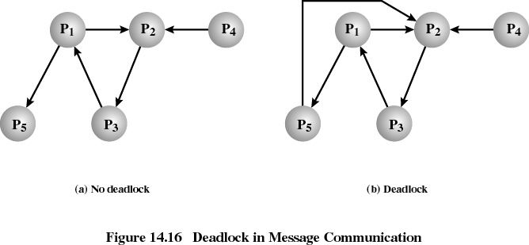
Deadlock in message communication: Mutual waiting (cont.)

Slide 15
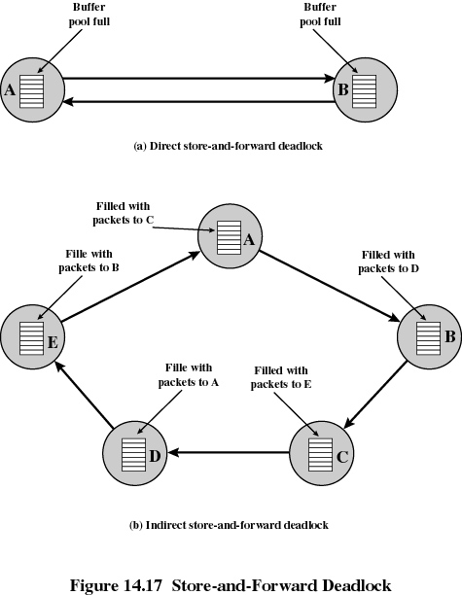
Deadlock in message communication
Unavailability of Message Buffers
  Deadlock can occur in the allocation of buffers for the storage of messages in transit (Example: packet-switching data networks)
  Direct store-and-forward deadlock
    Example:
      Two packet switching nodes, each using a common buffer pool from which buffers are assigned to packets on demand
      Buffer space for A is filled with packets destined for B
      Buffer space for B is filled with packets destined for A
      Neither node can transmit or receive packets: deadlock
    Solution: Use separate buffers, one for each link

Slide 16
Deadlock in message communication (cont.)
Unavailability of Message Buffers (cont.)
  Indirect store-and-forward deadlock
    For each node, the queue to the adjacent node in one direction is full with packets destined for the next node beyond

Slide 17
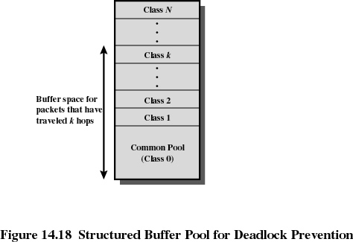
Deadlock in message communication (cont.)
Unavailability of Message Buffers (cont.)
  Indirect store-and-forward deadlock: Solution
    Use a structured buffer pool, hierarchically organized, with N+1 levels (N is the maximum number of hops an any network path)
    Common pool – class 0 is unrestricted: any incoming packet can be stored there
    Buffers at level k (where 0 < k ≤ N) are reserved for packets that have traveled at least k hops so far
    Under heavy load, buffers will fill from 0 to N
    When buffers fill to level k, new incoming packets that passed k hops or less are discarded
    No direct or indirect store-and-forward deadlock can occur

Slide 18
Deadlock in message communication: (cont.)
Unavailability of Message Buffers (cont.)
  Deadlock in a distributed OS using message passing for inter-process communication
    A non-blocking Send operation requires a buffer to hold outgoing messages
    Example 1
      Process X has a buffer of size n
      After sending n messages, buffer is full
      When sending message n+1, process X will block until sufficient buffer is freed
    Example 2
      Process X has a buffer of size n
      Process Y has a buffer of size m
      Both buffers, n and m, become full and the two processes are blocked: deadlock
    Possible solutions
      Prevention: estimate maximum number of messages in transit and allocate corresponding number of buffers
      Detection: detect deadlock and roll back one of the processes

Slide 19
Deadlock in message communication:
Unavailability of message buffers (cont.)

